Slide 1
RFID BASED ATTENDANCE SYSTEM
Submitted by:

Slide 2
contents
Project overview
Block diagram
Power supply
Microcontroller
RFID
LCD
Software requirements
Schematic & Working of the project
Advantages
Applications
Future scope
Conclusion

Slide 3
Project overview
The main functionality of this project is to verify the identity / attendance of the user who needs to access it through RFID.
For this purpose the authorized person is given an RFID card.
This card contains an integrated circuit that is used for storing, processing information through modulating and demodulating of the radio frequency signal that is being transmitted.
Thus, the data stored in this card is referred as the identification/attendance of the person.
Once, the person places the card in front of the RFID card reader, it reads the data and verifies it with that data present in the system and if it matches then it displays a message as valid entry and allows accessing the device or else displays invalid and denies the access/attendance.

Slide 4
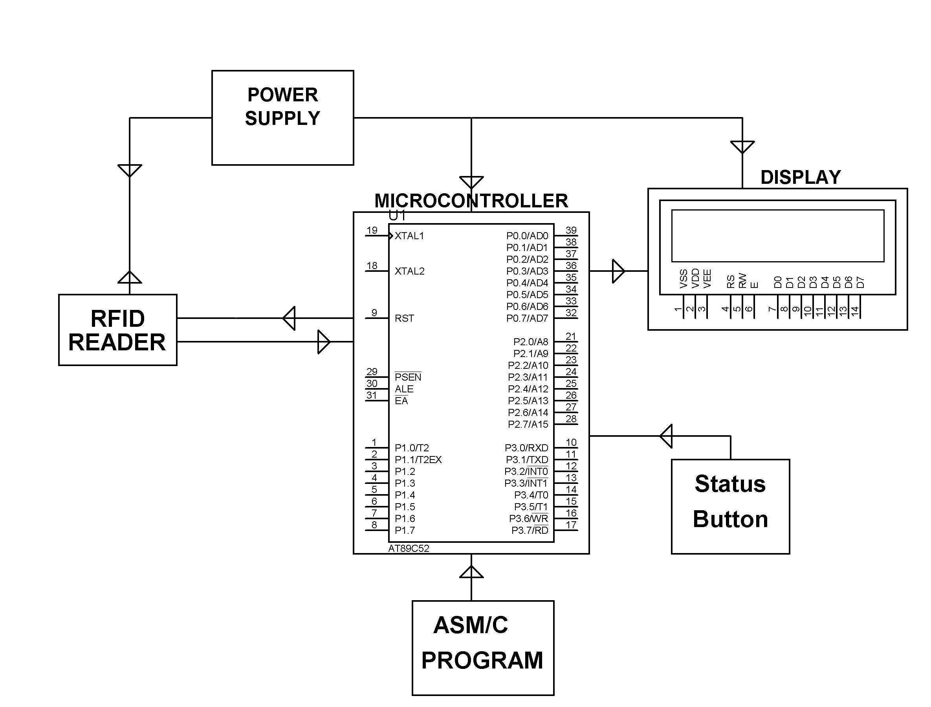
Block diagram

Slide 5
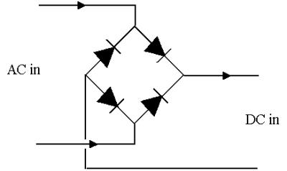
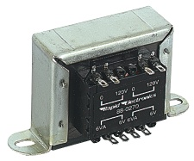
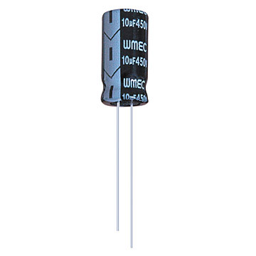
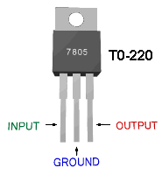
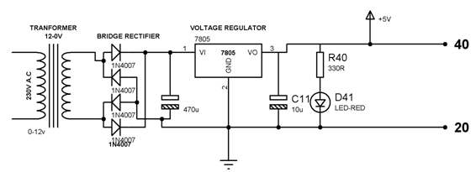
Power supply
Step down transformer Bridge rectifier Filter Regulator

Slide 6
Contd..
The 230V AC supply is first stepped down to 12V AC using a step down transformer.
This is then converted to DC using bridge rectifier.
The AC ripples is filtered out by using a capacitor and given to the input pin of voltage regulator 7805.
At output pin of this regulator we get a constant 5V DC which is used for MC and other ICs in this project.

Slide 7
Microcontroller
It is a smaller computer
Has on-chip RAM, ROM, I/O ports...
CPU
RAM
ROM
A single chip
Serial COM Port
I/O Port
Timer
Microcontroller

Slide 8
Block diagram of mc
External interrupts
On-chip ROM for program code
Timer/Counter
Interrupt Control
On-chip RAM
Timer 1
Counter Inputs
Timer 0
CPU
Bus Control
Serial Port
4 I/O Ports
OSC
P0 P1 P2 P3
TxD RxD
Address/Data

Slide 9
Features of MC
8K Bytes of In-System Programmable (ISP) Flash Memory
4.0V to 5.5V Operating Range
Fully Static Operation: 0 Hz to 33 MHz
256 x 8-bit Internal RAM
32 Programmable I/O Lines
Three 16-bit Timer/Counters
Eight Interrupt Sources
Full Duplex UART Serial Channel

Slide 10
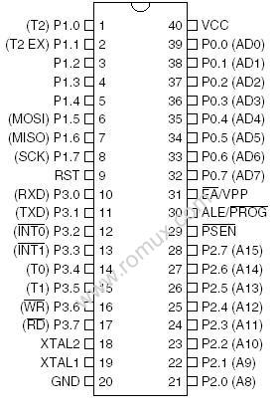
Pin description

Slide 11
Power on Reset circuit
+5V
+
10 uF
31
EA/VPP
X1
30 pF
19
11.0592 MHz
8.2 K
X2
30 pF
18
9
RST

Slide 12
RFid
Radio-frequency identification (RFID) is an automatic identification method, relying on storing and remotely retrieving data using devices called RFID tags or transponders.
RFID (radio frequency identification) is a technology that incorporates the use of electromagnetic or electrostatic coupling in the radio frequency (RF) portion of the electromagnetic spectrum to uniquely identify an object, animal, or person.
An alternative to bar code.
RFID is also called dedicated short range communication(DSRC)

Slide 13
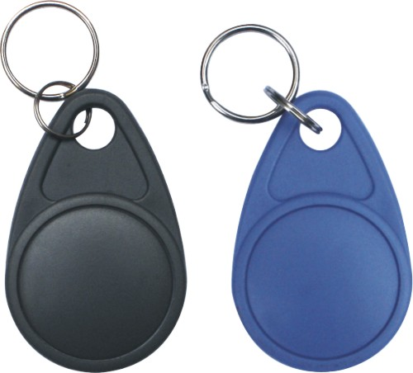
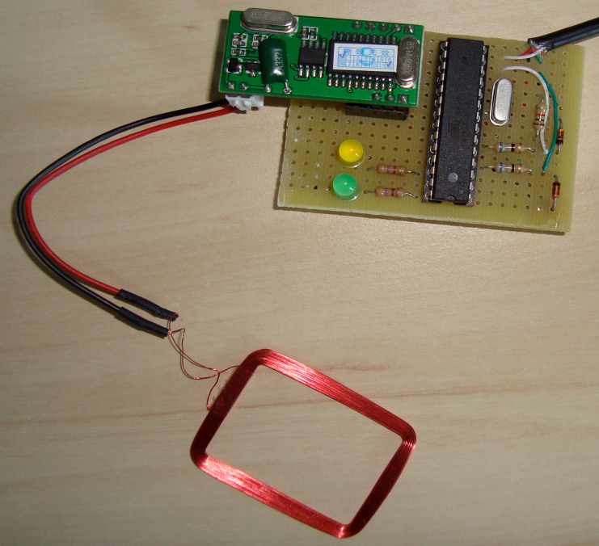
Contd..
RFID Benefits Versus Bar Code Labels and Scanning
Eliminates human error
Improves speed and efficiency
Increases information availability and location
Allows enhanced security
Delivers data with or without network connection
RFID Application
Manufacturing
Supply Chain, Logistics & Distribution
Security And Access Control
Parking, Bay And Terminal Management
Tool Collection

Slide 14
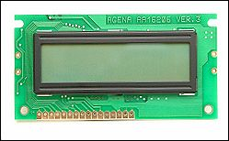
Liquid crystal display-lcd
Most common LCDs connected to the microcontrollers are 16x2 and 20x2 displays.
This means 16 characters per line by 2 lines and 20 characters per line by 2 lines, respectively.
The standard is referred to as HD44780U, which refers to the controller chip which receives data from an external source (and communicates directly with the LCD.

Slide 15
Contd..
If an 8-bit data bus is used the LCD will require 11 data lines(3 control lines plus the 8 lines for the data bus)
The three control lines are referred to as EN, RS, and RW
EN=Enable (used to tell the LCD that you are sending it data)
RS=Register Select. When RS=0; data is treated as a command & When RS=1; data being sent is text data.
R/W=Read/Write . When RW=0; the data written to the LCD & When RW=0; the data reading to the LCD.

Slide 16
Software requirements
Keil an ARM Company makes C compilers, macro assemblers, real-time kernels, debuggers, simulators, integrated environments, evaluation boards, and emulators for ARM7/ARM9/Cortex-M3, XC16x/C16x/ST10, 251, and 8051 MCU families.
Compilers are programs used to convert a High Level Language to object code. Desktop compilers produce an output object code for the underlying microprocessor, but not for other microprocessors.

Slide 17
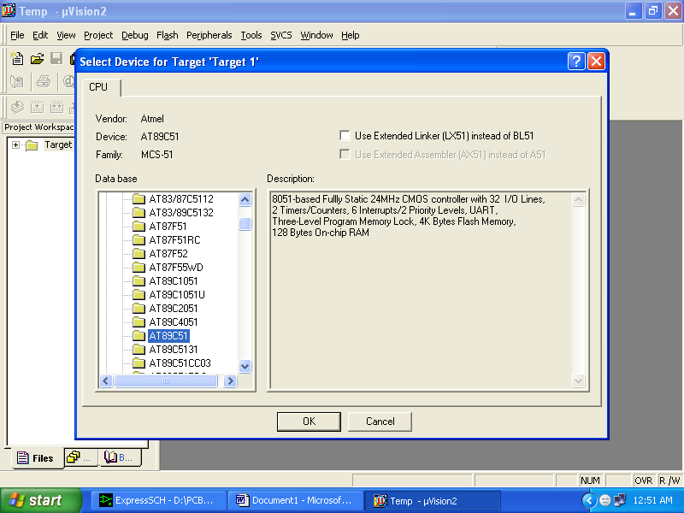
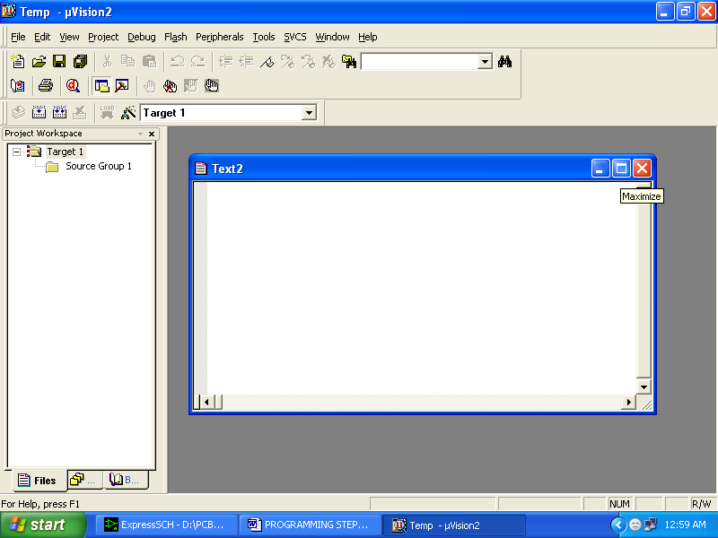
Contd..
i.e., the programs written in one of the HLL like ‘C’ will compile the code to run on the system for a particular processor like x86 (underlying microprocessor in the computer).
For example compilers for Dos platform is different from the Compilers for Unix platform So if one wants to define a compiler then compiler is a program that translates source code into object code.

Slide 18
Working of project
The project uses a RFID reader that sends a 125 KHz signals while a RFID card is swiped over the same.
The card used gets powered by inductive means with the coil inside the same duely rectified and filtered for a DC voltage to drive the inbuilt chip in the card.
Thus while the card is swiped over sends a valid data to the micro controller through level shifter IC MAX232 which while executed by the program compares with the available data.
The data then is updated with the data and time of swiping the card of the number of persons to be recorded for future retrieval.
When required one push button is connected to pin3.2 to get the display on LCD the status of the no of students present on the very day till the unit is kept powered ON.

Slide 19


Slide 20


